Slide 1
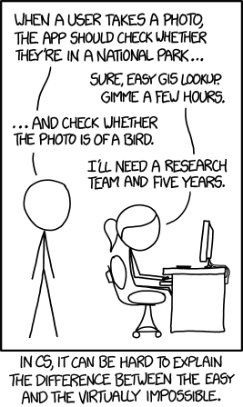
https://xkcd.com/1425/
Tasks turned 11 years old yesterday
I started HBO-ICT 11 years and 1 month ago today
I could not have dreamed what’s possible now
I could also not have dreamed that CRUD apps are still as hard as they were in 2014 🙈

Slide 2

Architecture
Modern Programming Practices

Slide 3

At the end of this lecture, you can
Make informed decisions about different architectural patterns
Define and use
Layers pattern
Client-Server pattern
Explain and use RESTful HTTP APIs

Slide 4
Back to basics
Talking about software

Slide 5

What is software?

Slide 6
A bunch of 0s and 1s that get executed on some weird block of pure silicon with human-made impurities that are connected by copper
Software ¯\_(ツ)_/¯

Slide 7

How do we design software?

Slide 8


Slide 9

But honestly, how do we design software?

Slide 10


Slide 11
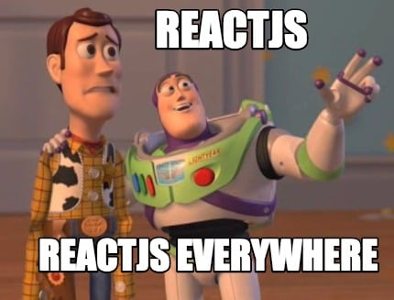
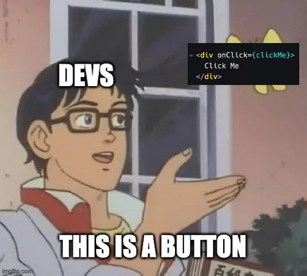
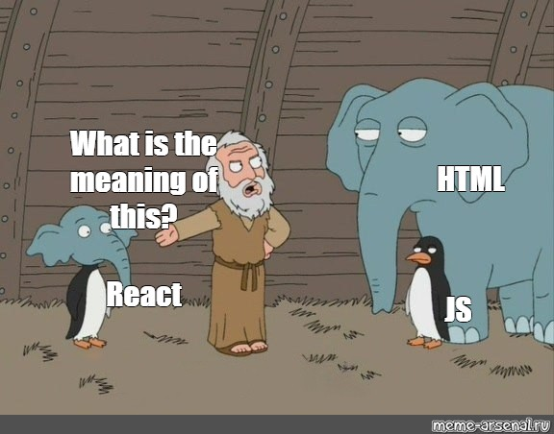

Slide 12

Golden Hammer
“If the only tool you have is a hammer, it is tempting
to treat everything as if it were a nail”
Abraham Maslov, 1966

Slide 13
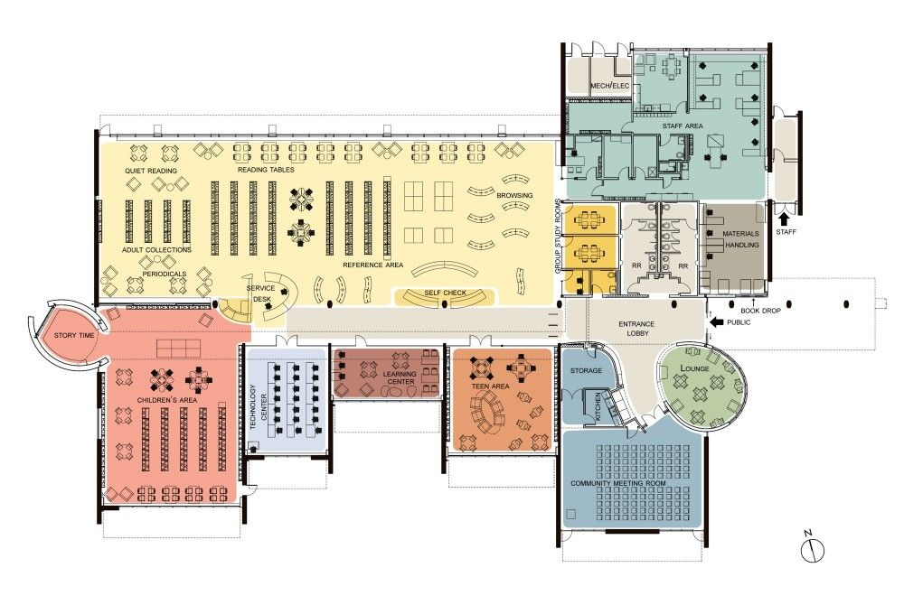

Slide 14
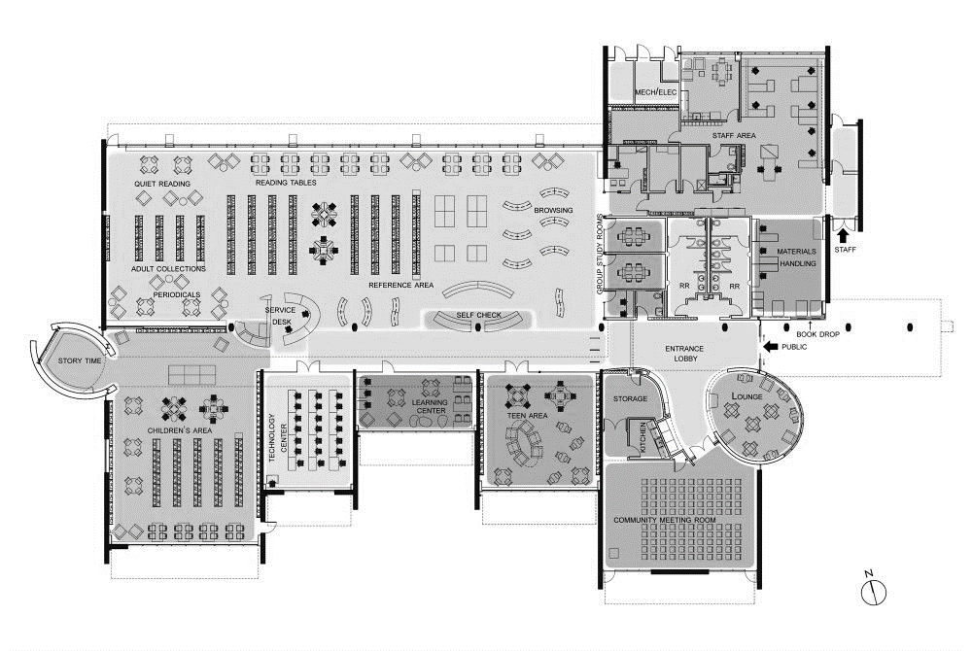


Slide 15
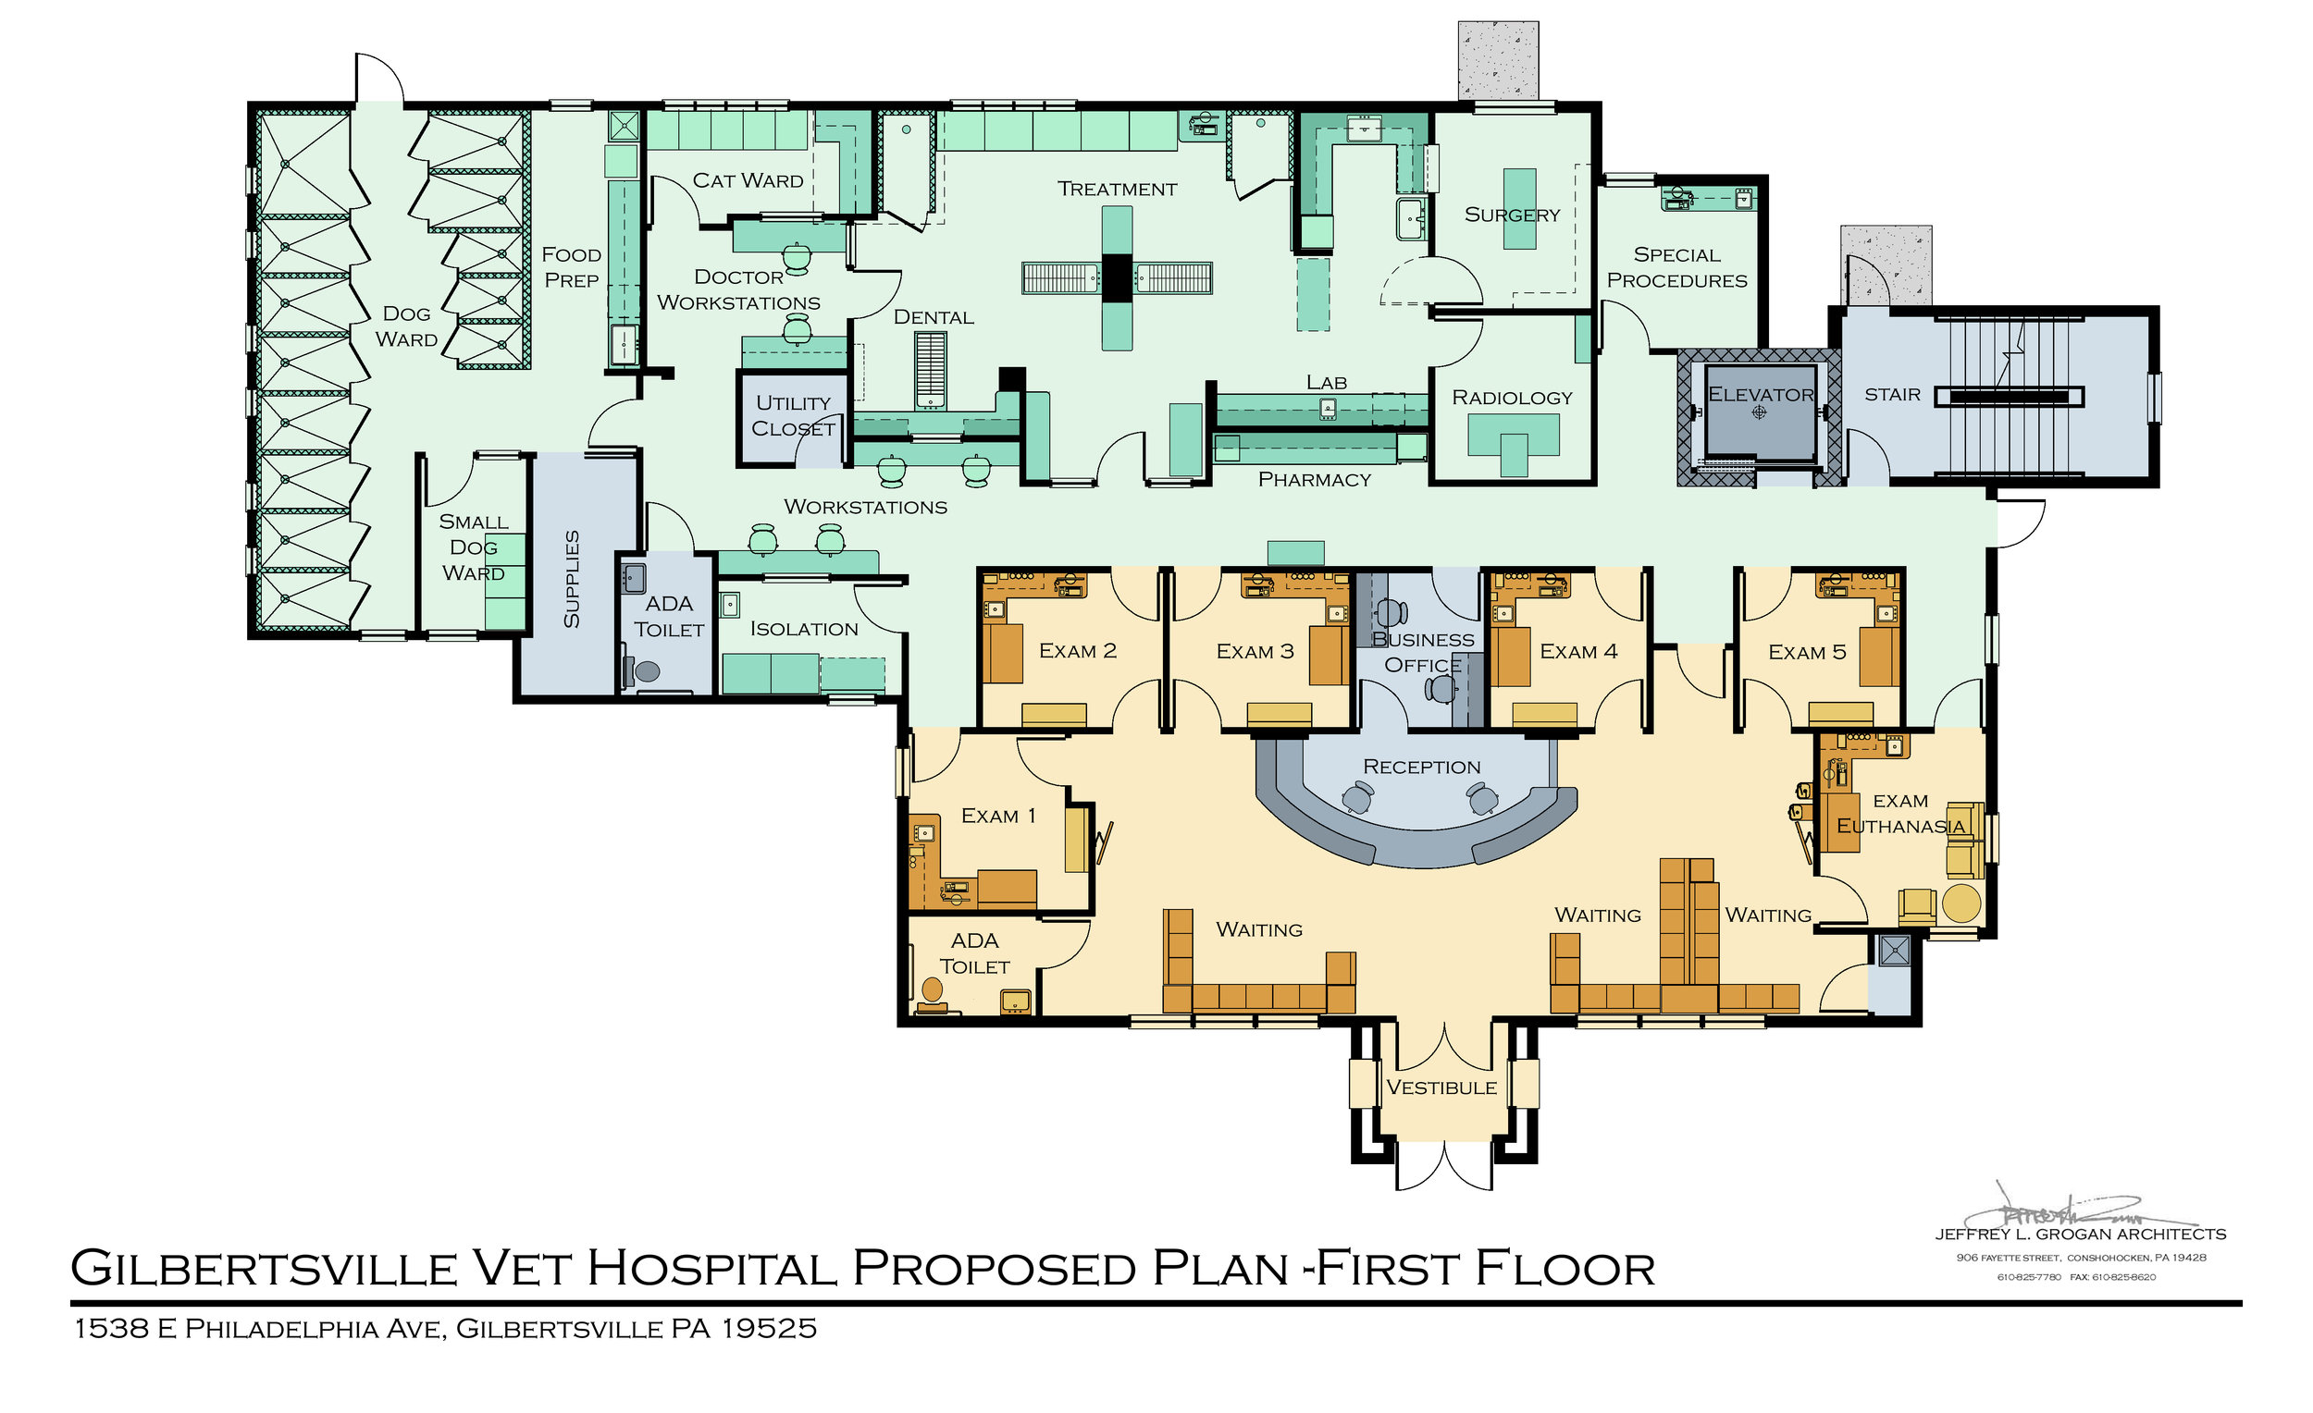

Slide 16
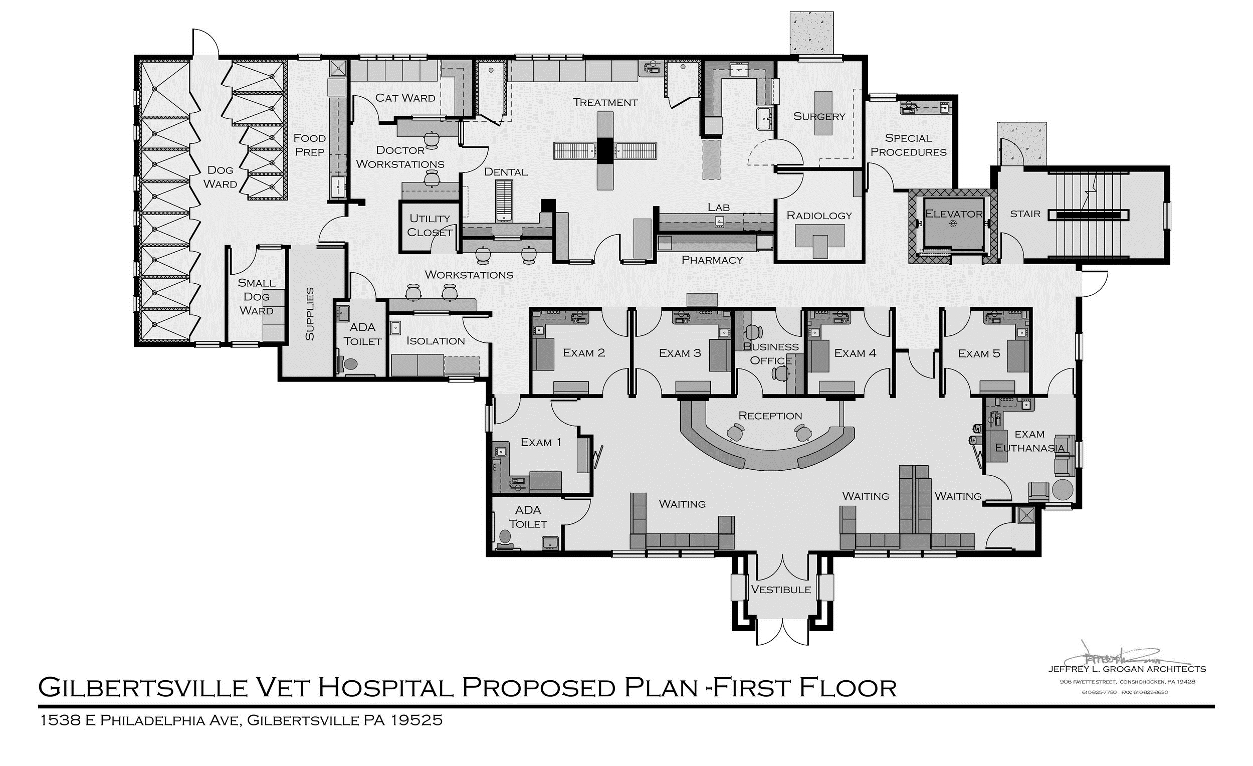


Slide 17
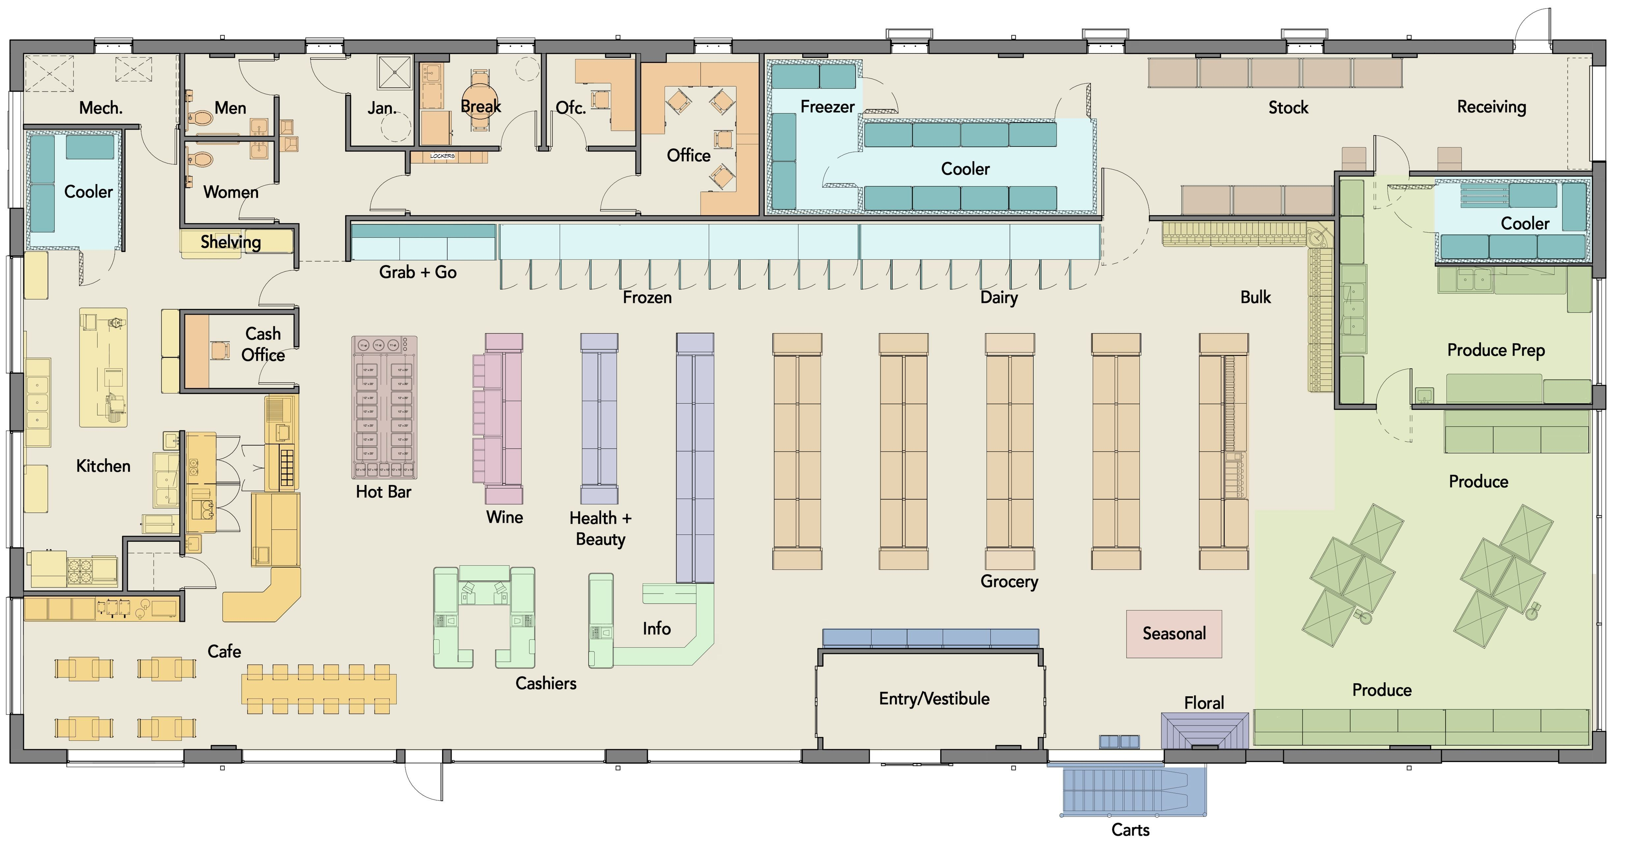

Slide 18

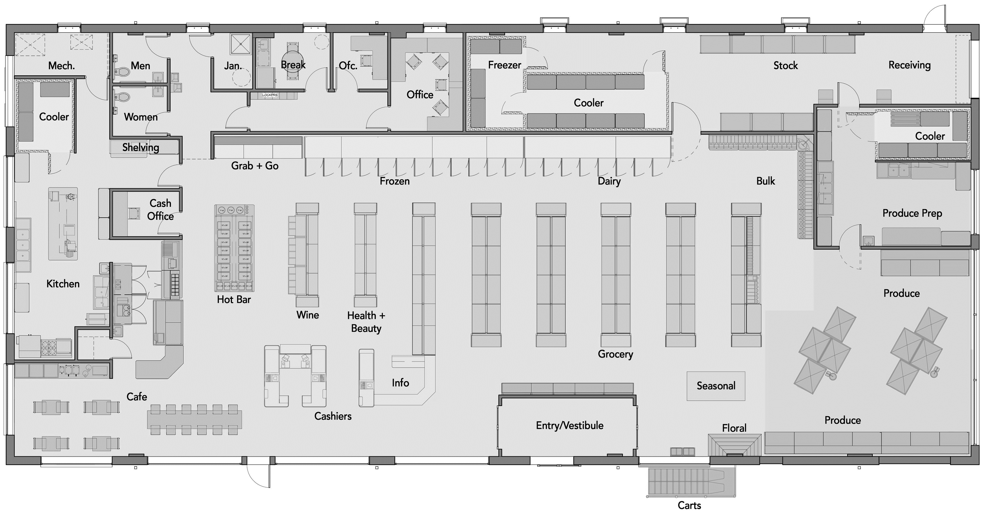

Slide 19
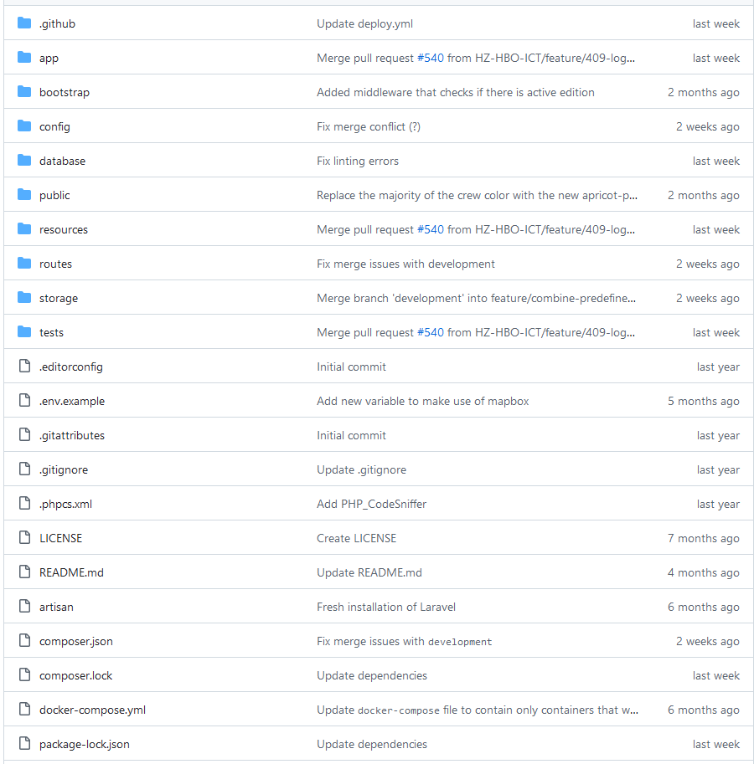

Slide 20


Slide 21
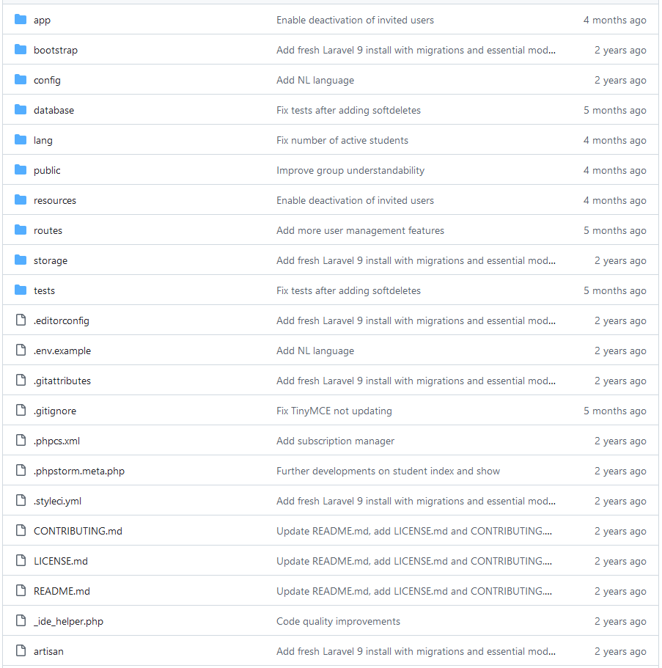

Slide 22


Slide 23
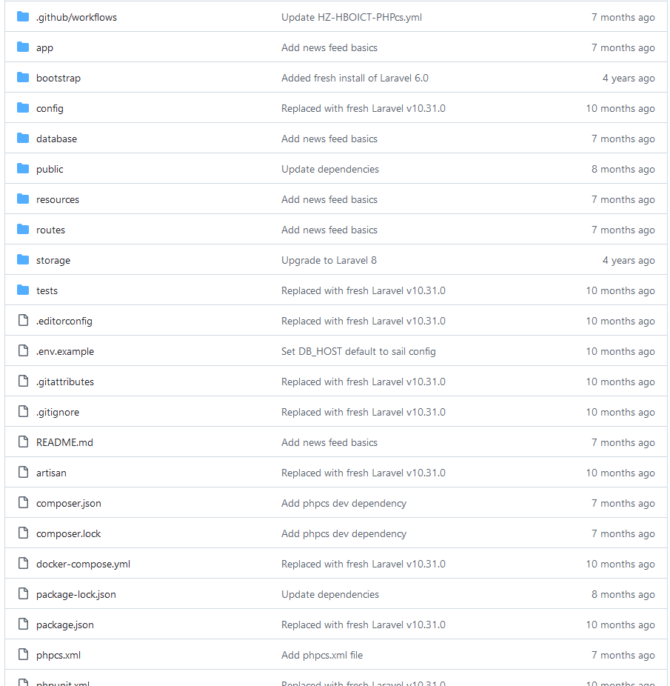

Slide 24


Slide 25
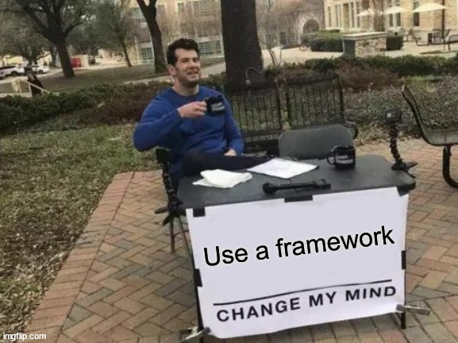

Slide 26
Vacancy: Software Architect
Skills
Experience
Truly understand business needs
Translate needs into technical solution
Communicate solution with engineers
Programming language A, B and C
Frameworks X, Y and QQ
Databases, both SQL and NoSQL
Docker

Slide 27
Vacancy: Software Architect
Skills
Experience
Truly understand business needs
Translate needs into technical solution
Communicate solution with engineers
Programming language A, B and C
Frameworks X, Y and QQ
Databases, both SQL and NoSQL
Docker

Slide 28
Translation levels
Context
Containers
Components
Code

Slide 29
Translation levels
Context that the system will live in
Containers that system is split in
Components make up groups of related functionality in a container
Code is what you write those components in

Slide 30
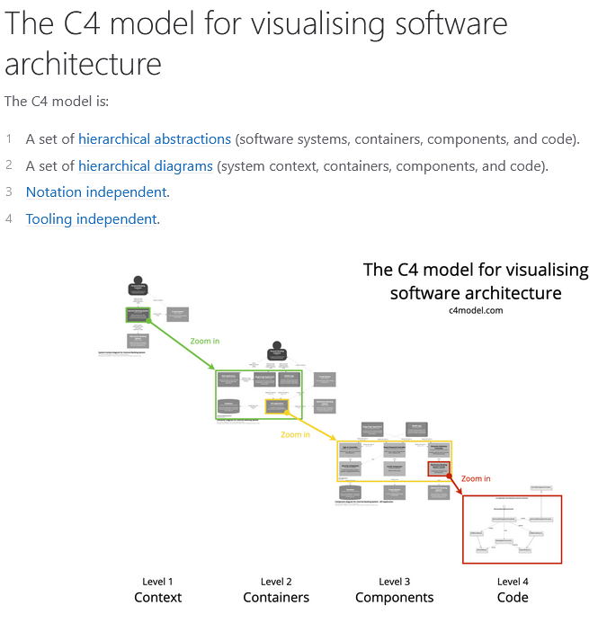

Slide 31
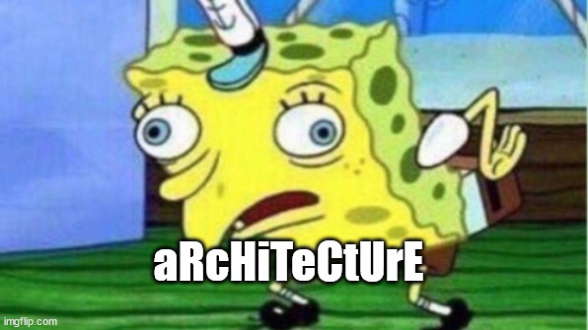

Slide 32
What is software architecture?

Slide 33
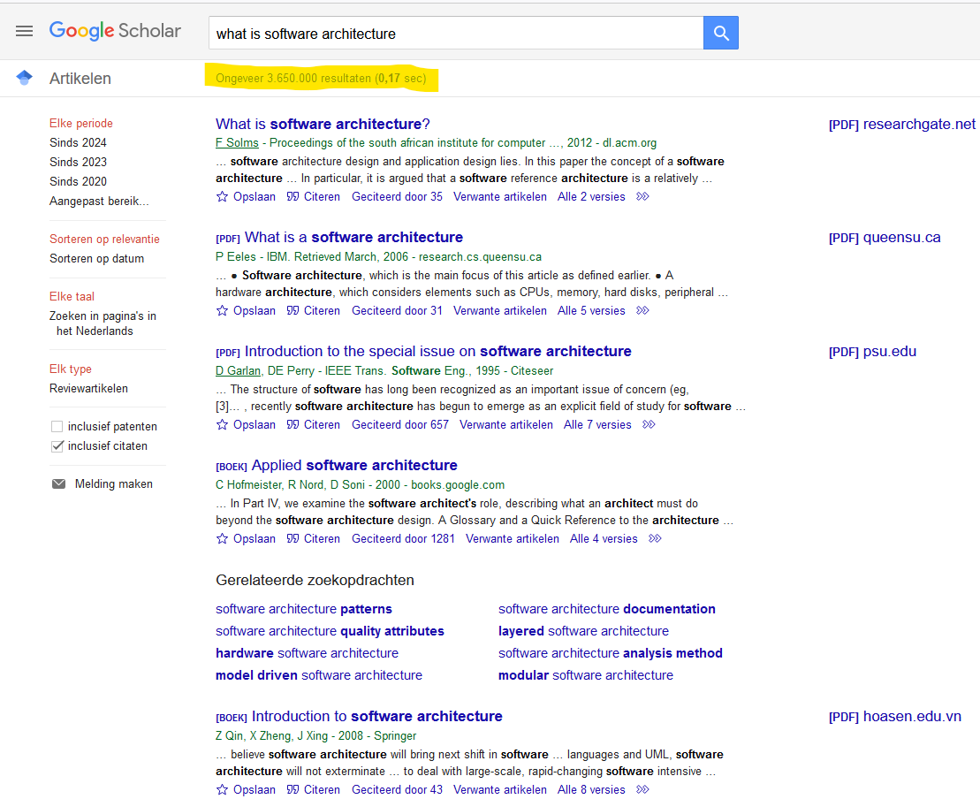

Slide 34
IEEE definition
The highest level concept of a system in its environment. The architecture of a software system (at a given point in time) is its organization or structure of significant components interacting through interfaces, those components being composed of successively smaller components and interfaces

Slide 35
Lecturer opinion
I don’t agree
I agree with Martin Fowler (see rec. reading)
Architecture is the decisions you wish you could get right early in a project

Slide 36
Lecturer opinion
Architecture is the decisions you wish you could get right early in a project
Why? Those decision are hard to change
They are almost irreversible
They want you to rewrite it all

Slide 37
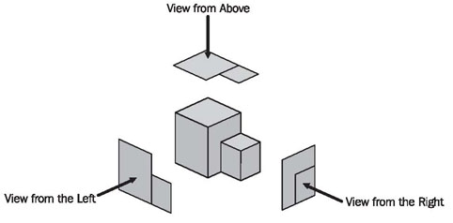
Disclaimer

Slide 38
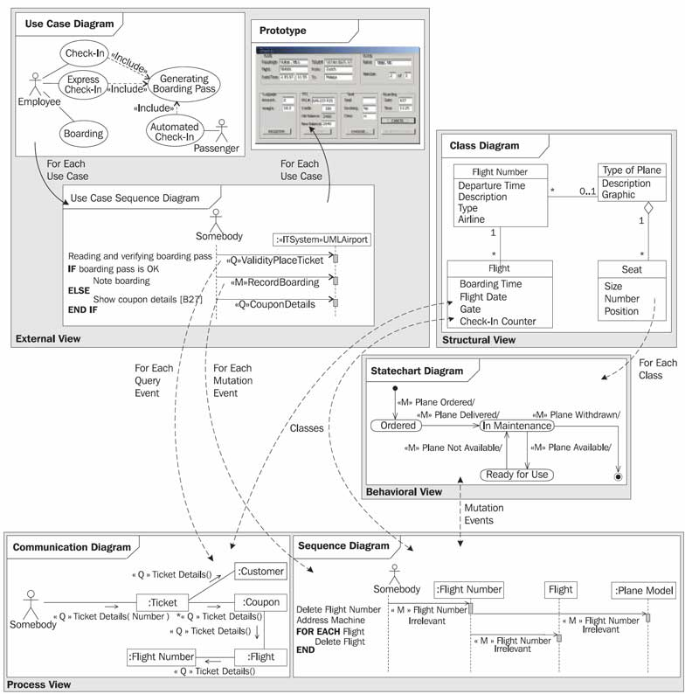

Slide 39
4+1 view architecture by Philippe Kruchten (read it!)
Scenarios
Logical view
Development view
Process view
Physical view

Slide 40
4+1 view architecture, modernized
How the code will be structured
→ SDE
What the user cares about
→ UX Design
Real life events
External view
Structural view
Interaction view
Behavioral view
What takes place in the system when the user uses it
→ FDE1 + 2
What can happen to individual objects?
→ OOP + FDE1

Slide 41
4+1 view architecture, modernized
Real life events
External view
Structural view
Interaction view
Behavioral view

Slide 42
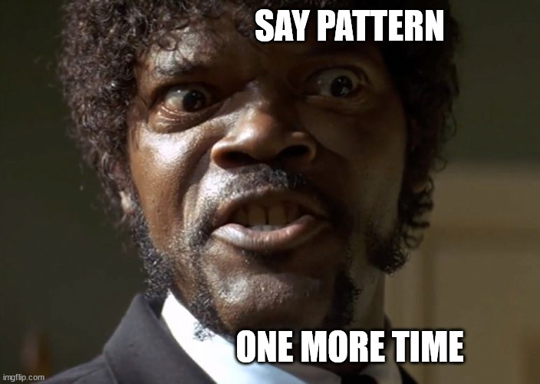
Architectural patterns
Layer pattern
Client-server pattern
Master-slave pattern
Pipe-filter pattern
Broker pattern
Peer-to-peer pattern
Event-bus pattern

Slide 43
Layer pattern
Helps structuring applications into groups of tasks
Each layer is a level of abstraction
https://www.joelonsoftware.com/2002/11/11/the-law-of-leaky-abstractions/

Slide 44
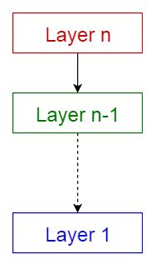

Slide 45
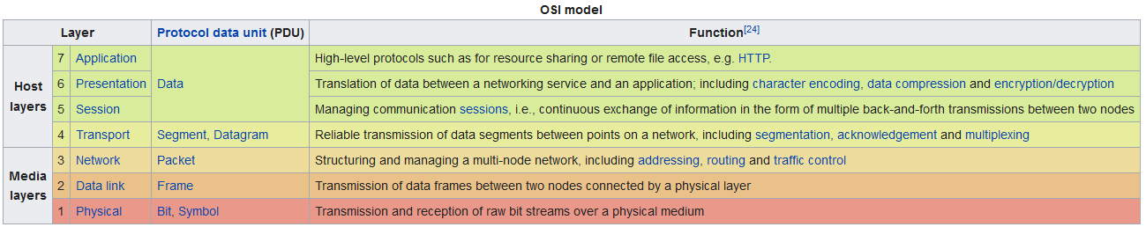

Slide 46
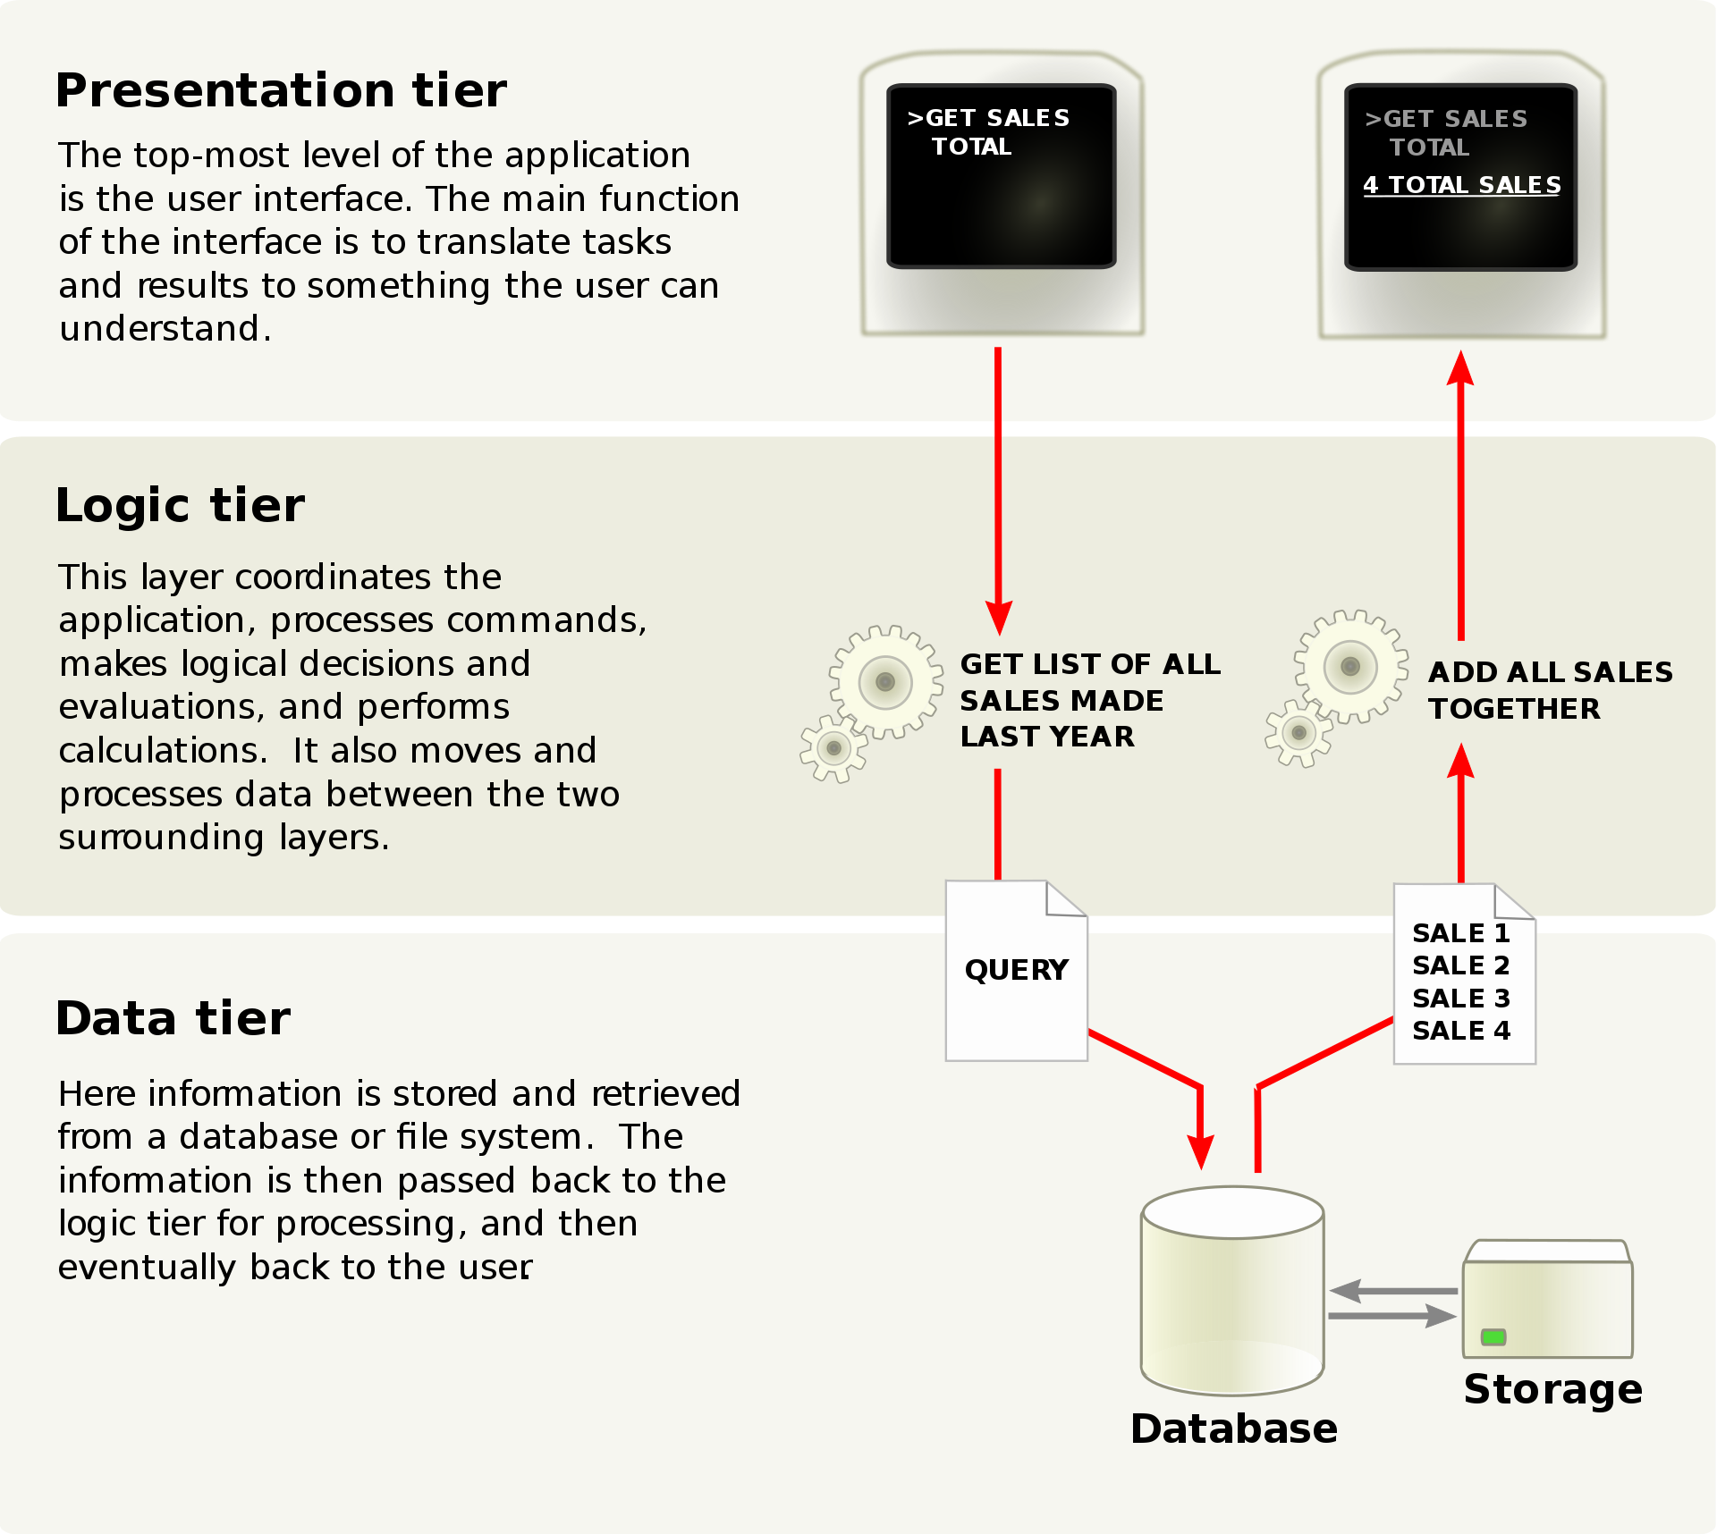

“Three-tier”

Slide 47
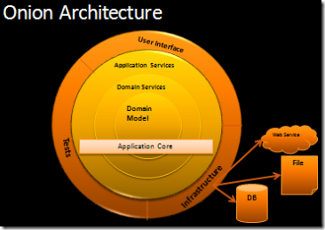

Slide 48
Benefits and issues
Benefits
Issues
Layer can be used by any other higher layer
Standardisation is easy
Dependencies are local
Changes in lower layers affect higher layers (leaky abstraction)
Interfaces require a lot of work to define

Slide 49
Client-server pattern
Server is permanently active and listens to many clients
In fact, form of layered pattern!
Client = high level
Server = low level

Slide 50
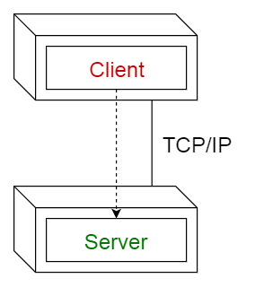

Slide 51
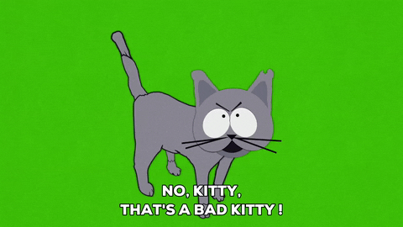
Master-slave pattern
Bad name, not only for historic connotations
But it also does not describe what it does

Slide 52
Master-slave pattern (suggested: Minion pattern)
Master distributes work among identical slave components
Computates result from work returned by slaves
https://space.stackexchange.com/questions/9243/what-computer-and-software-is-used-by-the-falcon-9

Slide 53
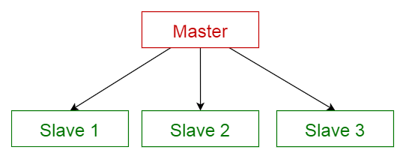

Slide 54
Benefits and issues
Benefits
Issues
Very fault-tolerant
Allows parallel execution
Accuracy of computation (different strategies)
Only when problem is decomposable
Latency in communication

Slide 55
Pipe-filter pattern
Describes structure for dealing with streaming data
Processing steps are filters, communication is pipes

Slide 56
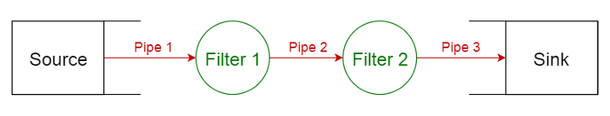

Slide 57
Benefits and issues
Benefits
Issues
Easy to add new filters
Filters are reusable
Filters can be developed due to standard interface
Lots of data transformation
Hard to use for interactive applications

Slide 58
Broker pattern
Structures decoupled components that have to communicate
i.e. Browser + web server

Slide 59
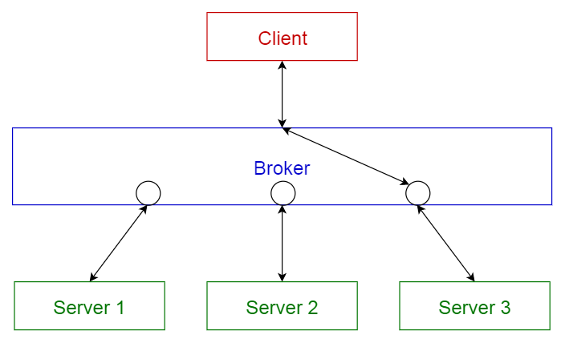
DNS?
Load balancer?

Slide 60
Benefits and issues
Benefits
Issues
Easy to add/modify/delete servers without modifying client
Hard to define standards and interfaces

Slide 61
Peer-to-peer pattern
“Symmetric” client-server: clients can act as servers and server can act as clients
i.e. BitTorrent network, blockchain

Slide 62
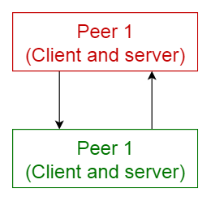

Slide 63
Benefits and issues
Benefits
Issues
Nodes can use capacity of network
Little overhead
Very scalable
Configuration of network can change at runtime
No guarantees for quality
Need external trust to guarantee security (i.e. proof of work/stake in blockhain)

Slide 64
Event-bus pattern
Allows for completely asynchronous implementation of components
i.e. process monitoring, trading,

Slide 65
Event-bus pattern
Allows for completely asynchronous implementation of components
i.e. microservices, process monitoring, trading,

Slide 66
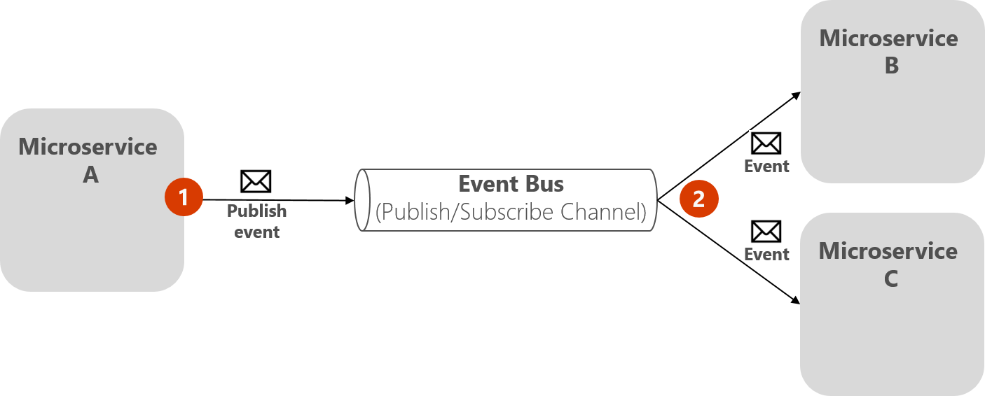
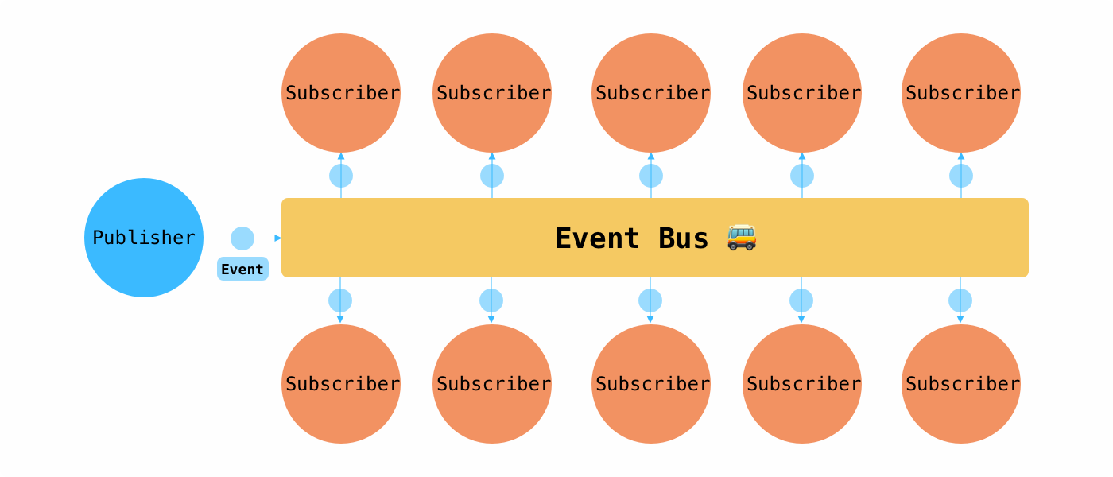

Slide 67
Year 2
What Rimmert told you are microservices
Are not.
They are a distributed monolith.

Slide 68
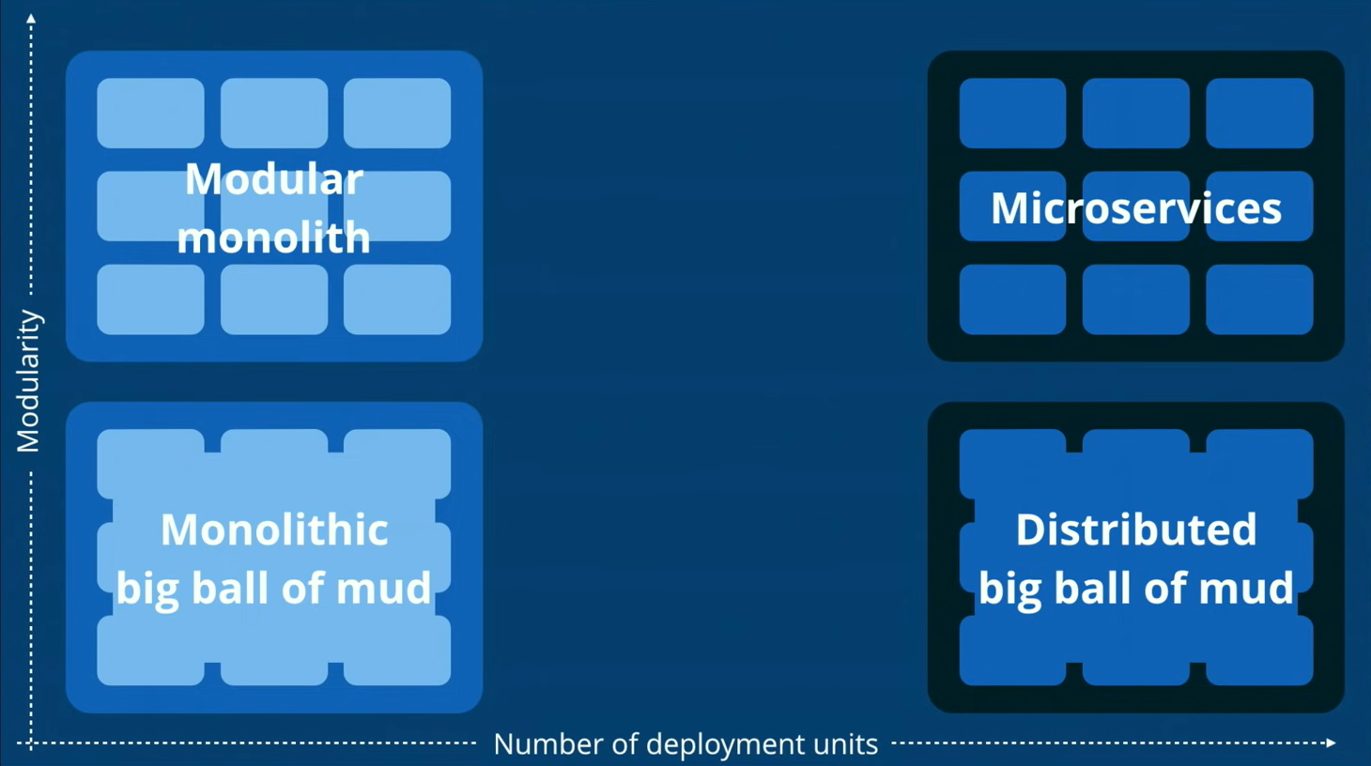

Slide 69
What you were taught
What you think you created
What you probably should have made
What you created

Slide 70
More = better for development
More = can be easier to scale up

Slide 71

Of course
You can combine any of them!

Slide 72

Assignment (10 min)
Discuss with your project members
What are the things you really don’t want to change in 10 weeks time?
Which (combination) of architecture(s) then suits those decisions well?

Slide 73
From what I understood

Slide 74

RESTful design

Slide 75
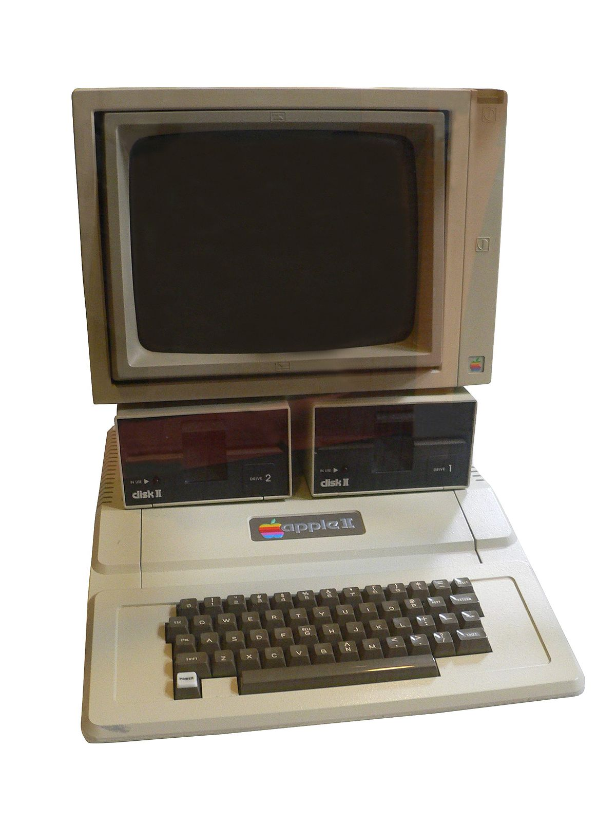

The internet!

Slide 76

In essence
A client asks for a resource
HTML page
Image
JSON object
…
The server answers with the resource

Slide 77
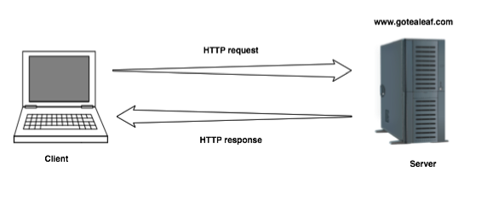
In essence

Slide 78

HTTP
HyperText Transfer Protocol
Protocol = contract
“You act according to it, or I won’t even answer”

Slide 79
HTTP request
Method
Path (URL)
Headers
Body (POST, PUT, PATCH)

Slide 80

RESTful
Representional State Transfer
No protocol, but best practice
https://www.ics.uci.edu/~fielding/pubs/dissertation/rest_arch_style.htm#sec_5_1
https://www.infoq.com/articles/rest-introduction/
https://oleb.net/2018/rest/

Slide 81
REST
Describes how a resource is sent (representational)
Describes that all information that the server needs should be sent on every request (state transfer)

Slide 82
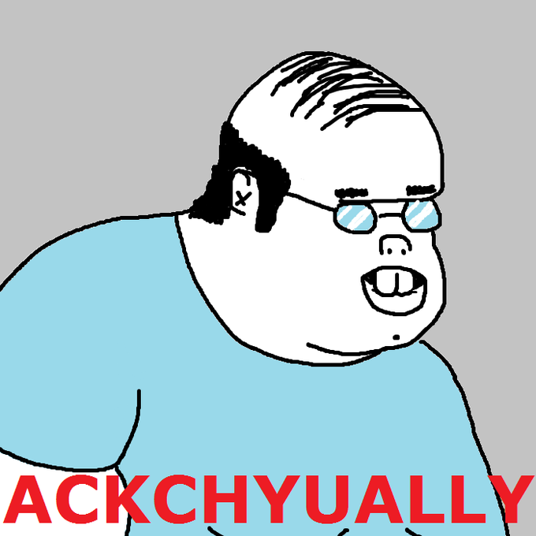

Slide 83
REST
REST describes how the internet works.
Case in point: Fielding mentions “API” for the grand total of 0 times in his thesis.
Describes how a resource is sent (representational)
Describes that all information that the server needs should be sent on every request (state transfer)

Slide 84

Stateless
What does “Stateless” mean?

Slide 85
Stateless
HTTP is built so that each pair of request/response is isolated
The server immediately forgets everything as soon a response is sent

Slide 86
Easy for the server
Bad request = “Oh well, have an error then”
Good request = “Here you go!”

Slide 87
Harder for the developer
All state must be developed in the application
Bad request = Catching error and handling it well

Slide 88
REST
It’s no secret you all know this already
Remember those resource controllers from Laravel?

Slide 89
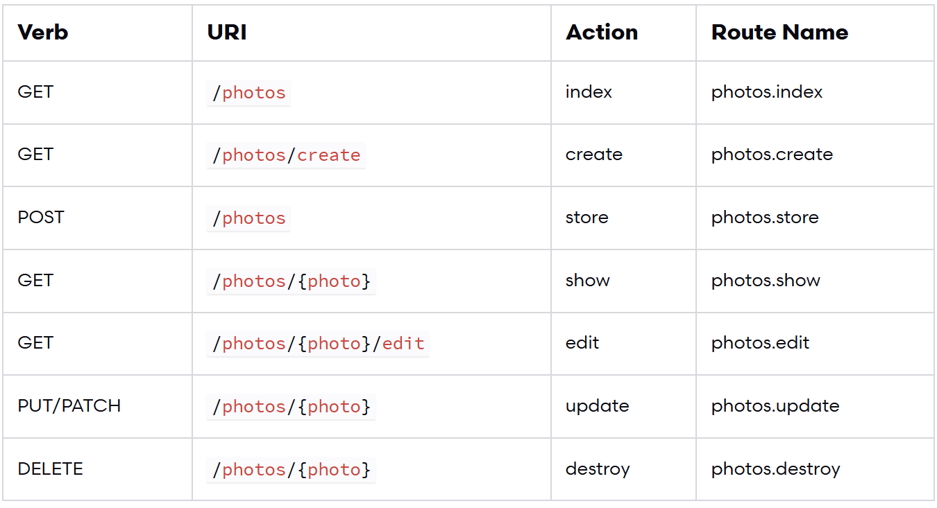

Slide 90
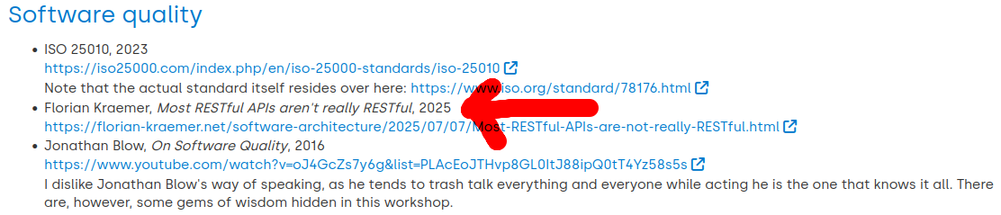

Slide 91
Interested?
https://launchschool.com/books/http
https://launchschool.com/books/working_with_apis
https://github.com/OAI/OpenAPI-Specification/

